Slide 1

Software Engineering
Pre-work: Day 3

Slide 2
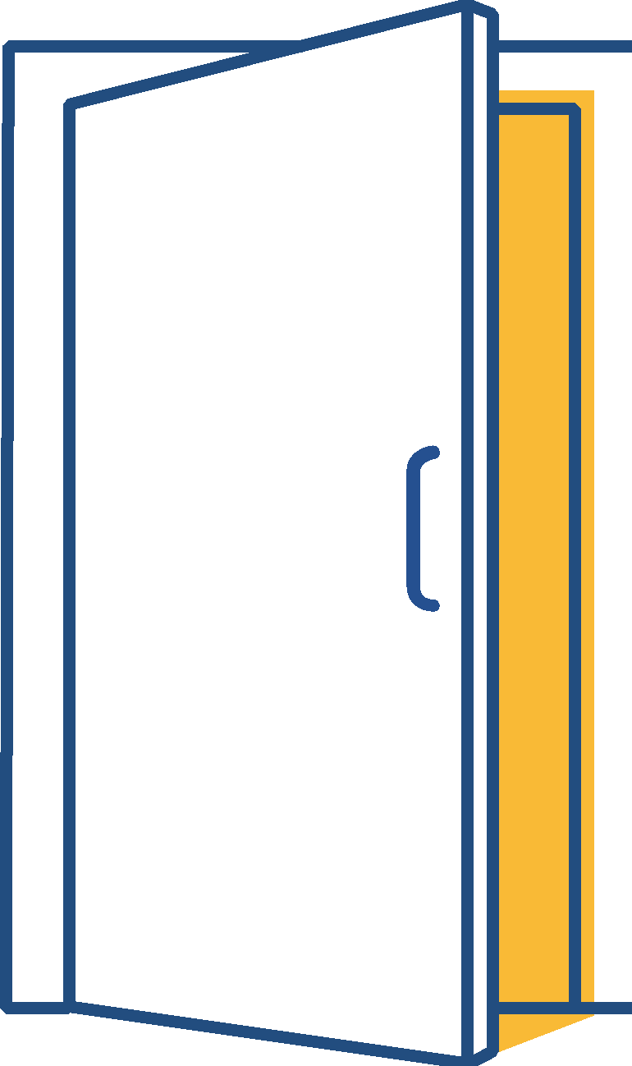
Learning Objectives
Separate styling into its own file
Learn how to position your html elements
Create a static web page

Slide 3
External Stylesheet
We just finished learning about Inline and internal styling as well as adding and targeting an id or class for more specific styling. Internal styling is better organized and more readable than inline styling, but we can take it a step further with an external stylesheet.
With an external stylesheet we can keep our HTML and CSS separate, making our code more organized. A CSS file will always have the extension .css at the end of its name.
The syntax remains the same and we no longer require any style tags.
CSS Syntax
body {
background-color: black;
}
.some-class {
color: white;
font-size: 10px;
}
#some-id {
width: 200px;
}

Slide 4

Linking stylesheet to HTML file
Linking a stylesheet to an html file is very straightforward. Assuming the stylesheet is named index.css:
You will need to add a self closing link tag to your html file inside of the head tags.
Inside of your link tag, insert the attribute rel and have it equal to “stylesheet”. This let’s you know what the relation is between the html file and the file you’re linking.
Now add the href attribute. The value for this attribute depends on the name of the file and its location. Assuming the stylesheet is in the same folder as the HTML file, the href attribute will equal to “index.css”
Example: <link rel=”stylesheet” href=”index.css”>

Slide 5
Positioning
HTML elements can be moved around using CSS. First you’ll need to specify how the element will move by using the css property position. There are a handful of values you can use with this property (Static, Relative, Fixed, Absolute, Sticky)
Static: Does not position an element. This is usually the default position of an element.
Relative: Positions an element relative to its normal position.
Fixed: Fixes an element to the page so it stays in the same place even when you scroll.
Absolute: Positions an element relative to their parent element. (i.e. If there’s a div inside of a div, the element on the inside is the child and the outer div is the parent). If there is no parent element, it will get positioned relative to the body.
Sticky: Toggles between relative and fixed depending on the scroll position

Slide 6
Positioning
Once you specify the position property of an element. You can then start moving the element. There are four ways to move an element.
Example
div {
position: relative;
top: 30px
}
This will move the div element 30 pixels from the left, relative to its normal position.
Top: Moves an element from the top
Right: Moves an element from the right
Left: Moves an element from the left
Bottom: Moves an element from the bottom

Slide 7
Margin and Padding
When creating your html elements you will notice that some of your elements are too close together. Given that we’ve just learned how to position elements that would probably be your approach to solving the problem, but that would be tedious and take up too much time. Luckily there are CSS properties that makes it easier for us to add space either inside or outside of an element, margin and padding.
Padding: Generates space around the content inside of an element.

Slide 8
Margin
Margin generates space around the outside of an element. Margin has four properties that lets you generate space to specific sides of an element.
margin-top: Generates space to the top of an element.
margin-bottom: Generates space to the bottom of an element.
margin-left: Generates space to the left of an element.
margin-right: Generates space to the right of an element.

Slide 9
Padding
Padding generates space around the content inside of an element. Padding has four properties that lets you generate space to specific sides of an element.
padding-top: Generates space to the top of the element’s content.
padding-bottom: Generates space to the bottom of the element’s content.
padding-left: Generates space to the left of the element’s content.
padding-right: Generates space to the right of the element’s content.

Slide 10
Margin and Padding Shortcuts
It can get very daunting having to specify which side receives margin or padding. Luckily there is an easier way to do this by just using the css properties margin and padding without specific sides.
Giving margin or padding one value will apply that value to ALL sides of the element.
You can add up to four values to margin or padding. If you give it four values it will add margin or padding to each side in the following order: Top, Right, Bottom, Left
Example
div {
margin: 40px
}
div {
margin: 40px 50px 30px 20px
}

Slide 11


